Slide 1


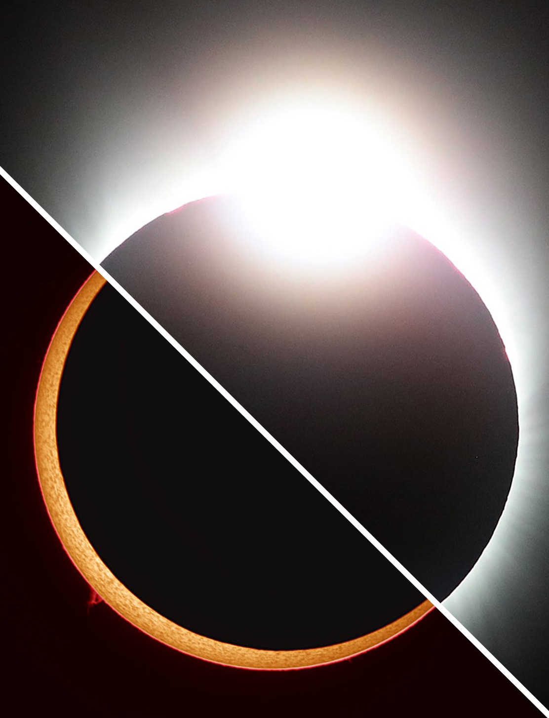
Arizona NASA
Eclipse Ballooning Project
Jacqueline Do¹, Dr. Thomas Sharp², Dr. Jnaneshwar Das³
¹Ira A. Fulton Schools of Engineering, Arizona State University
^{2,3}School of Earth and Space Exploration, Arizona State University
Arizona NASA Space Grant Statewide Consortium
April 21st and 22nd 2023

Slide 2
Overview

Slide 3
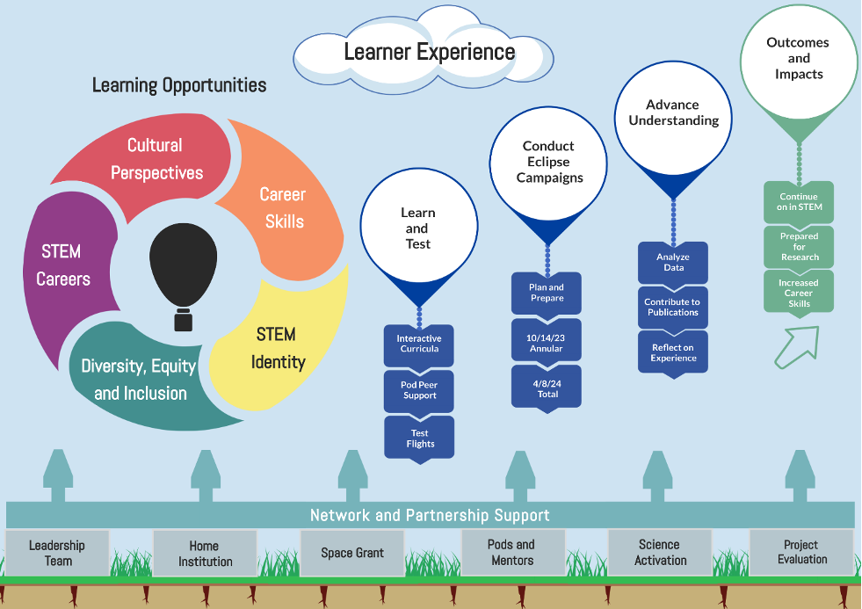
Source: https://eclipse.montana.edu/ebp-objectives.html

Slide 4
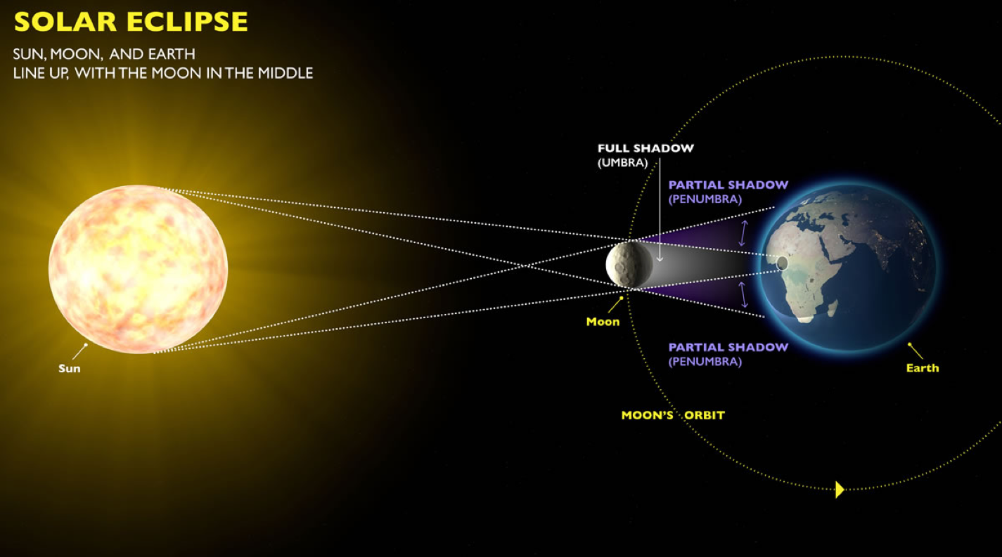
Source: https://communications.oregonstate.edu/space/what-solar-eclipse

Slide 5
Launch locations

Slide 6
October 14, 2023
Roswell, NM
April 8, 2024
Uvalde, TX
Source: https://eclipse.montana.edu/nepb-team-solicitation.html
Notes:
https://eclipse.montana.edu/nepb-team-solicitation.html

Slide 7
Mission

Slide 8
Develop, integrate, test, and deploy two 12-lb Engineering Track payloads provided by NASA Science Mission Directorates and Montana State University.

Slide 9
Objectives

Slide 10
Data acquisition and analysis
Live video streaming
Pre/Post-launch logistics

Slide 11
Engineering Track

Slide 12
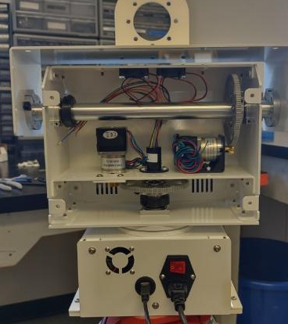
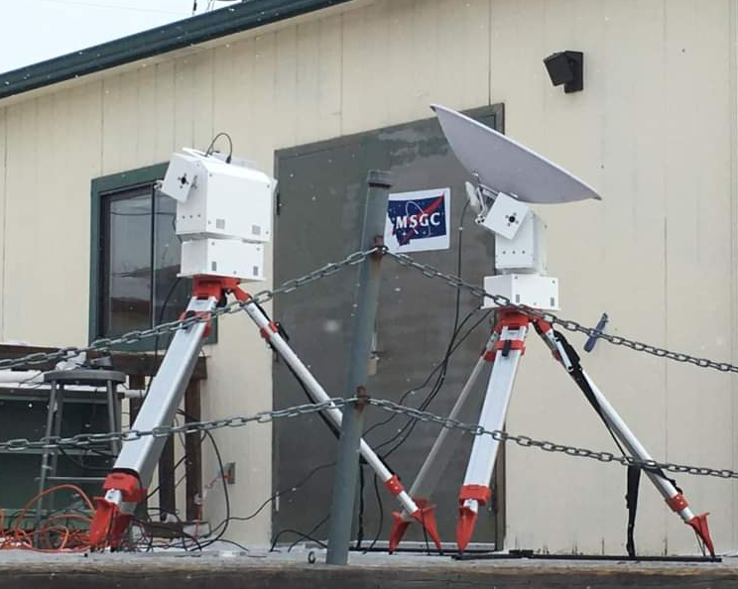
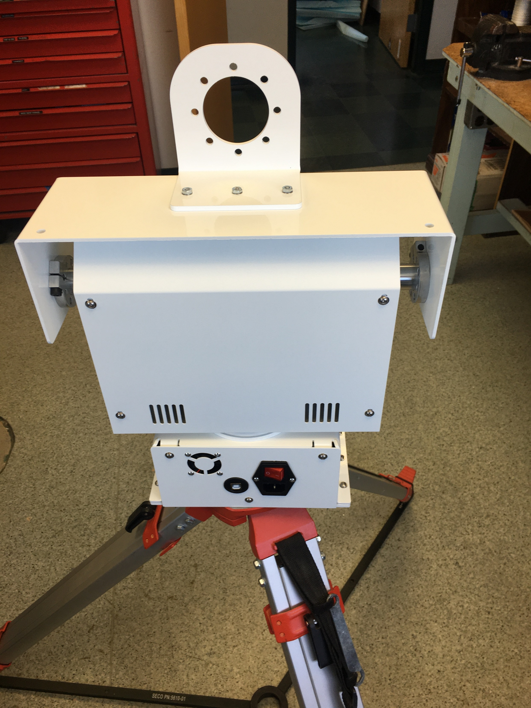
Ground Station
Credit: Montana State University

Slide 13
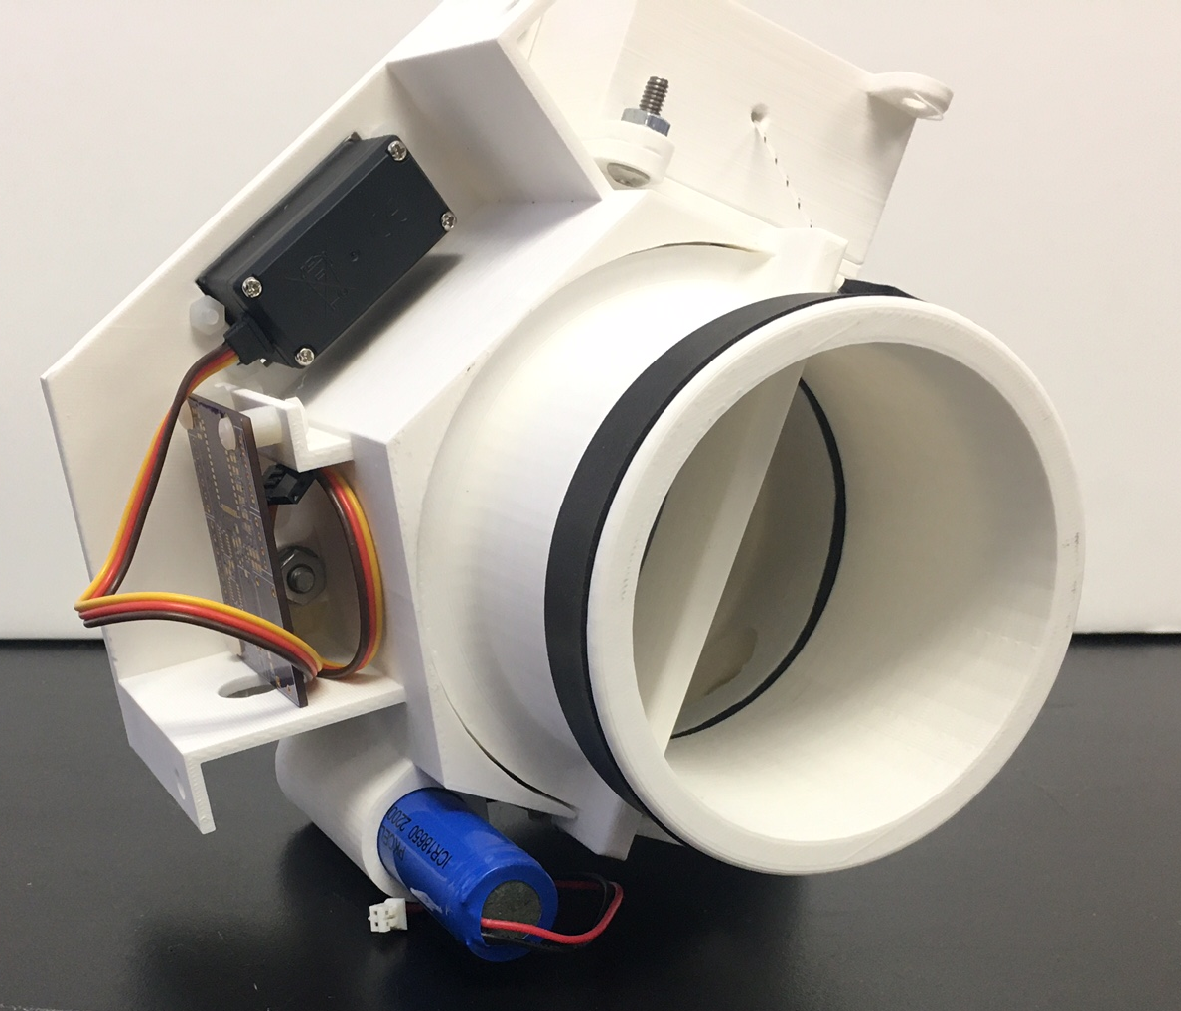
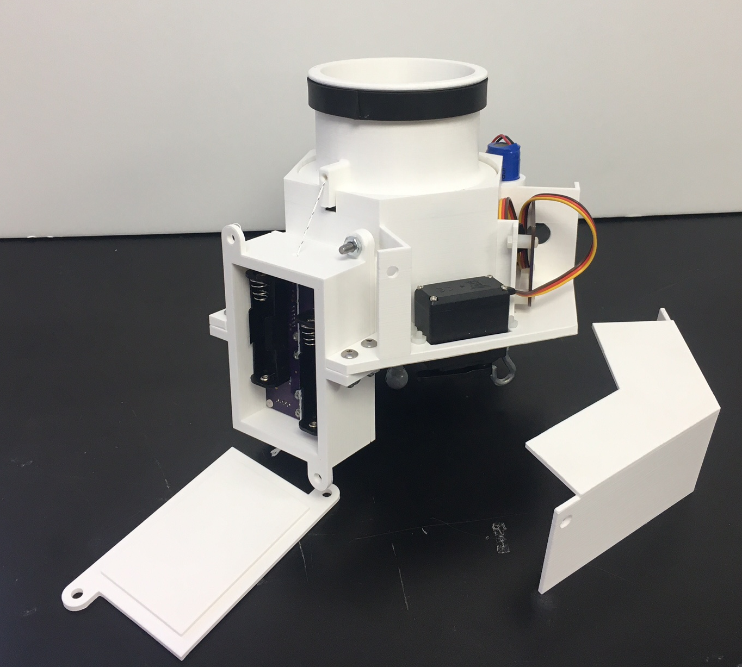
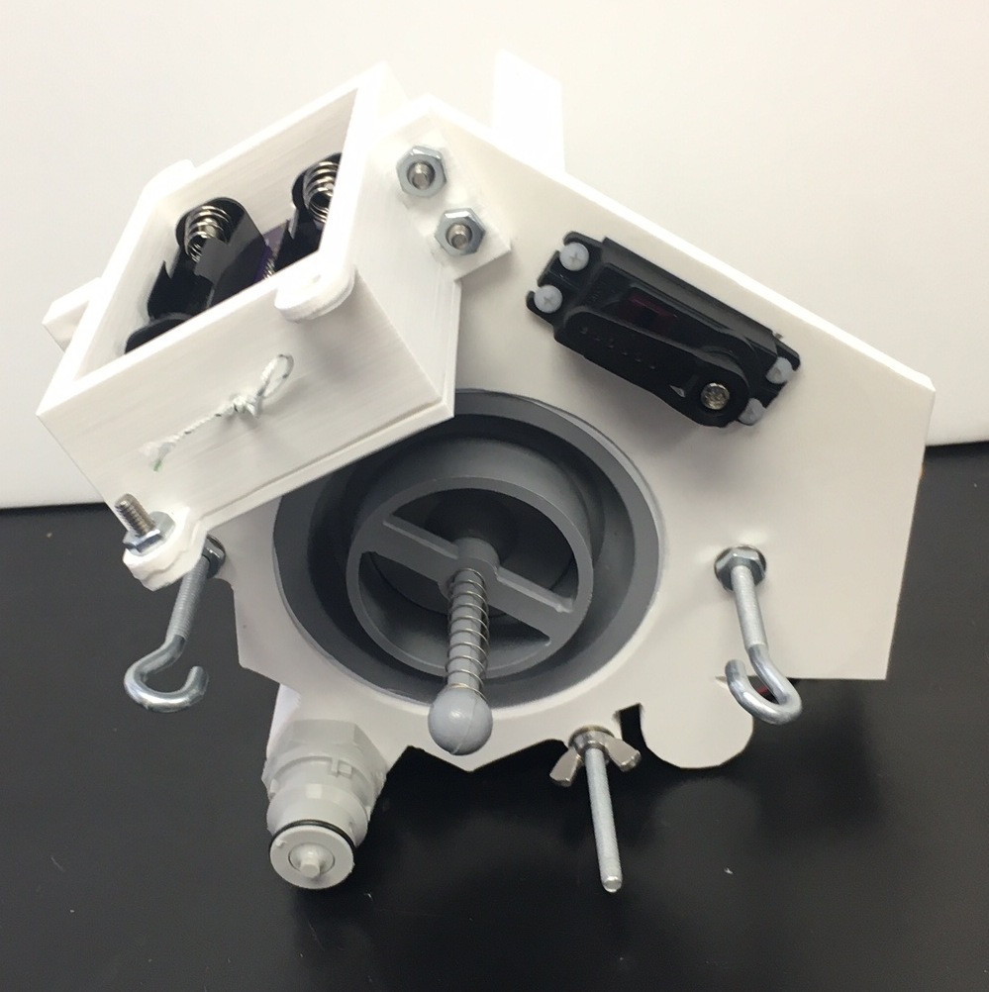
Balloon Vent Cutdown
Credit: Montana State University

Slide 14
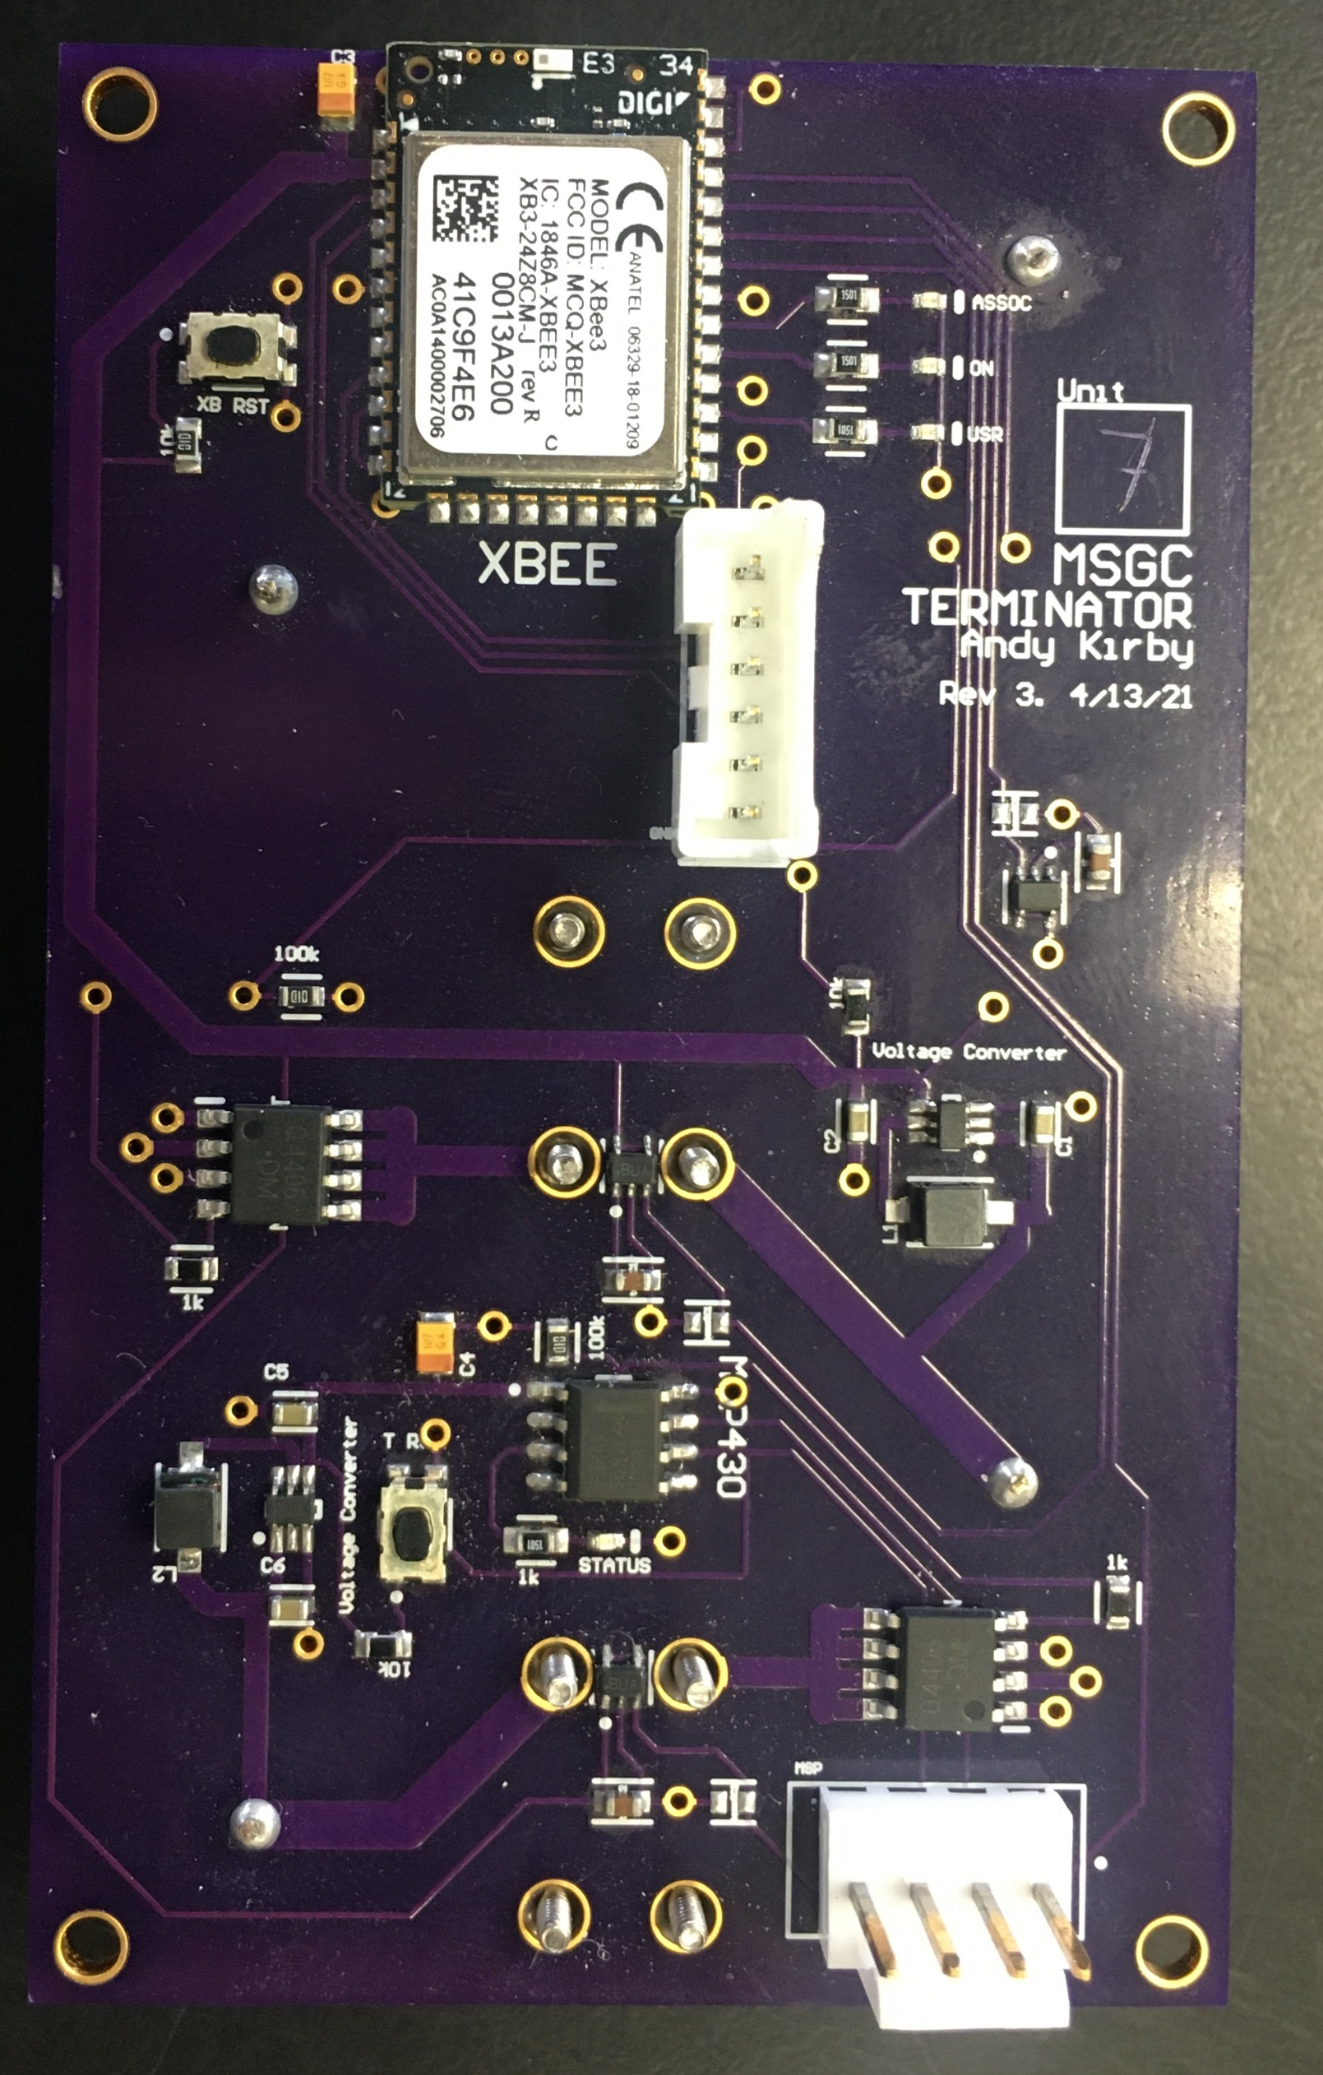
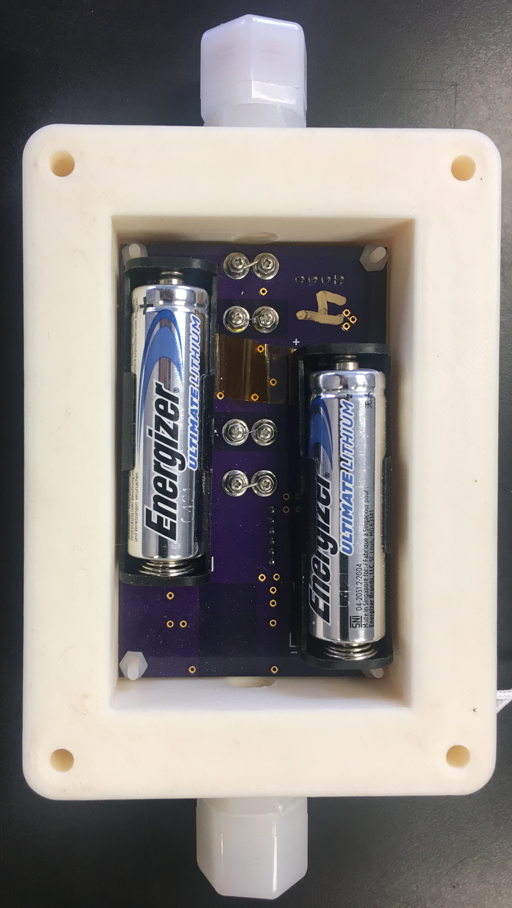
Balloon Vent Cutdown
Credit: Montana State University

Slide 15
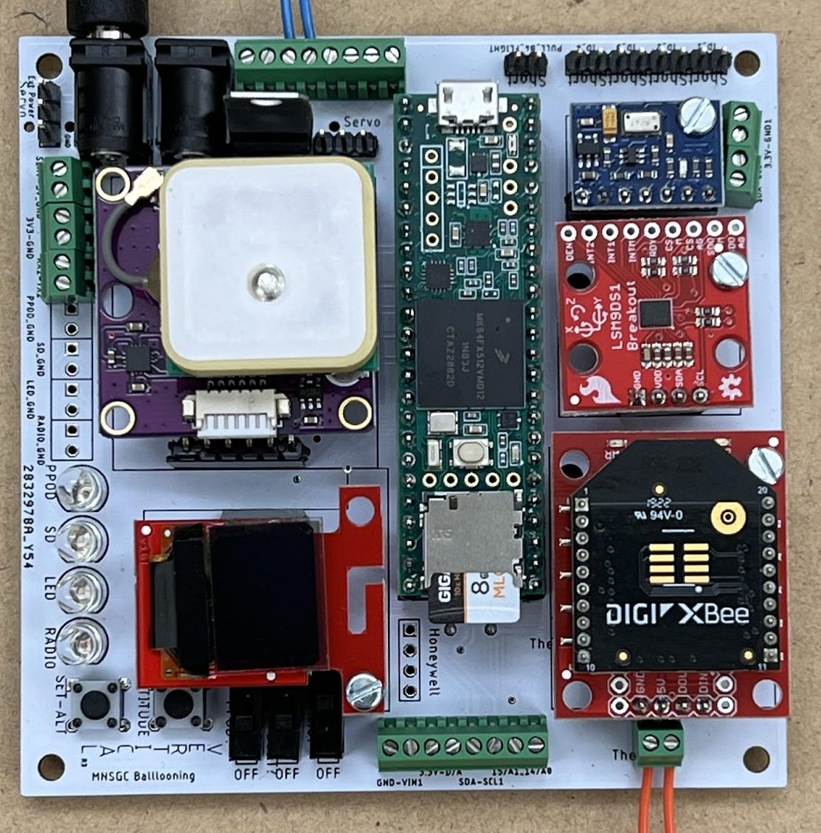
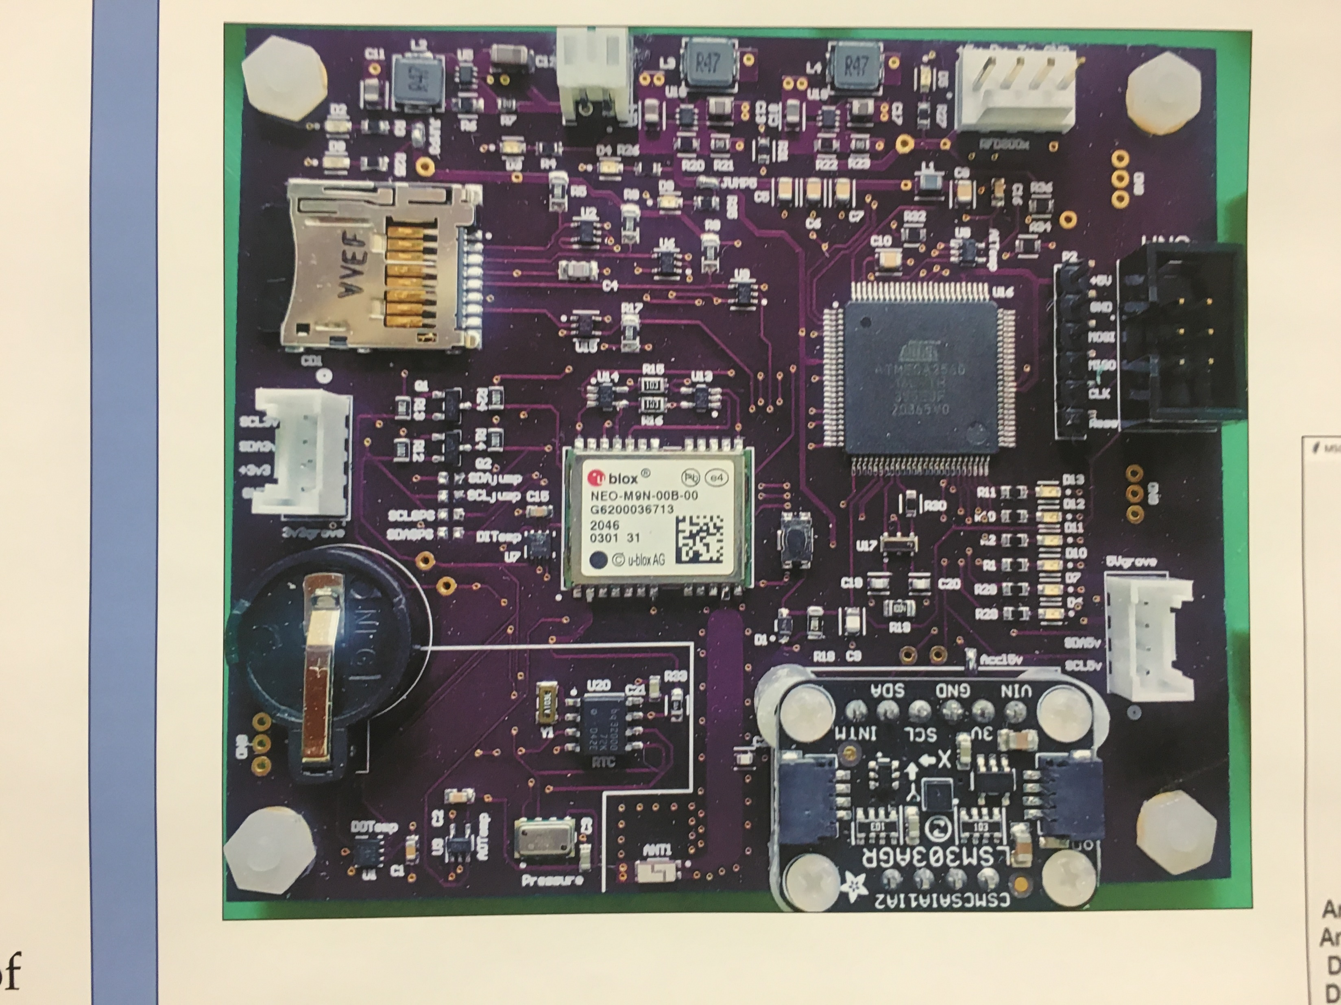
Atmospheric and GPS Systems
Credit: Montana State University

Slide 16
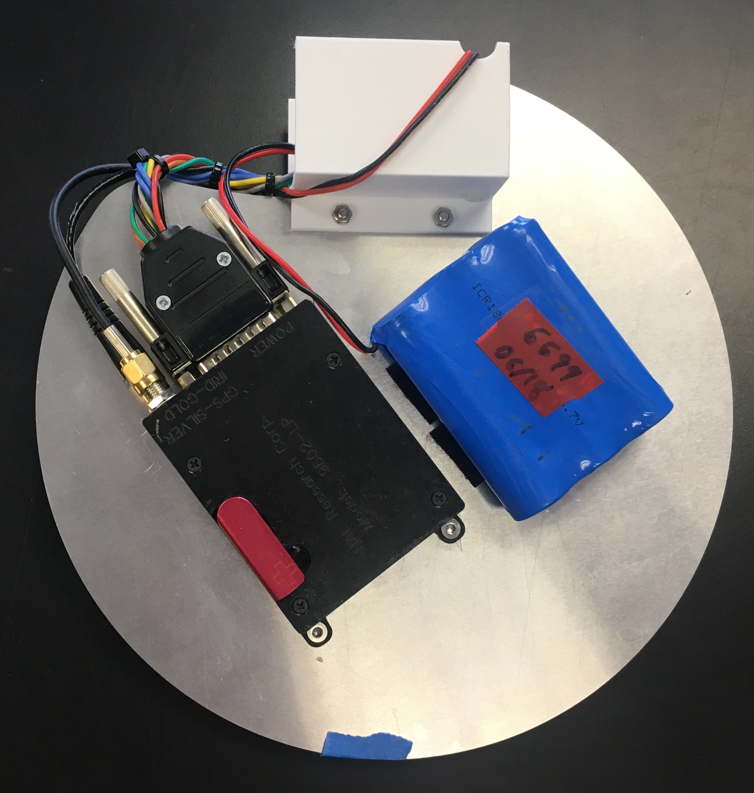
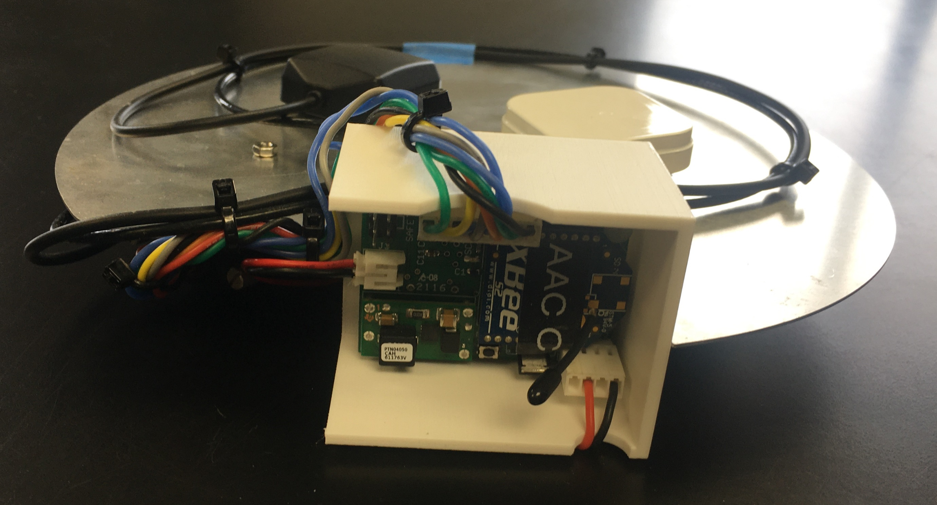
Iridium Tracking and Xbee Control
Credit: Montana State University

Slide 17
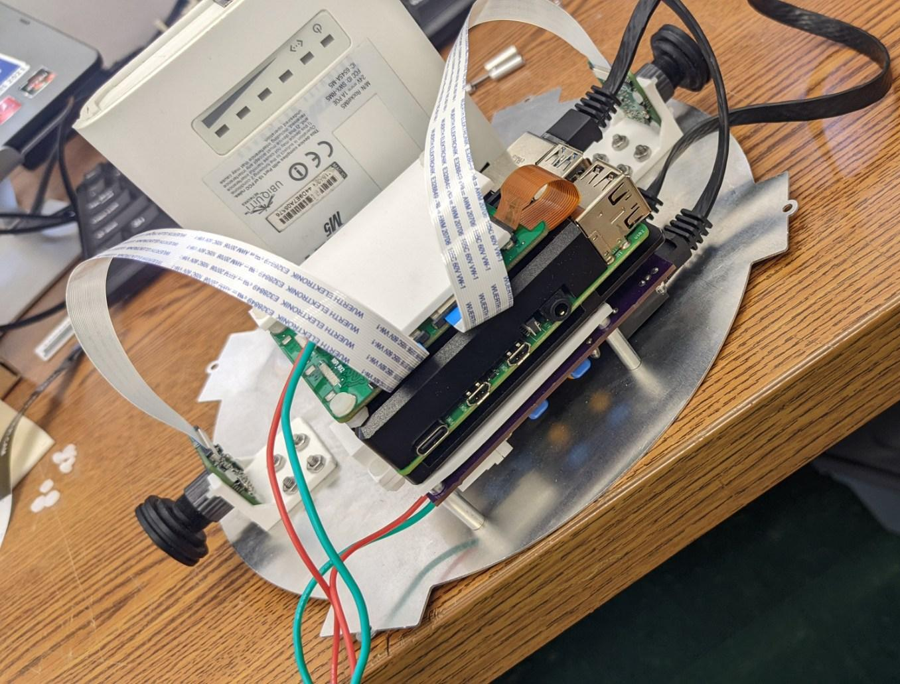
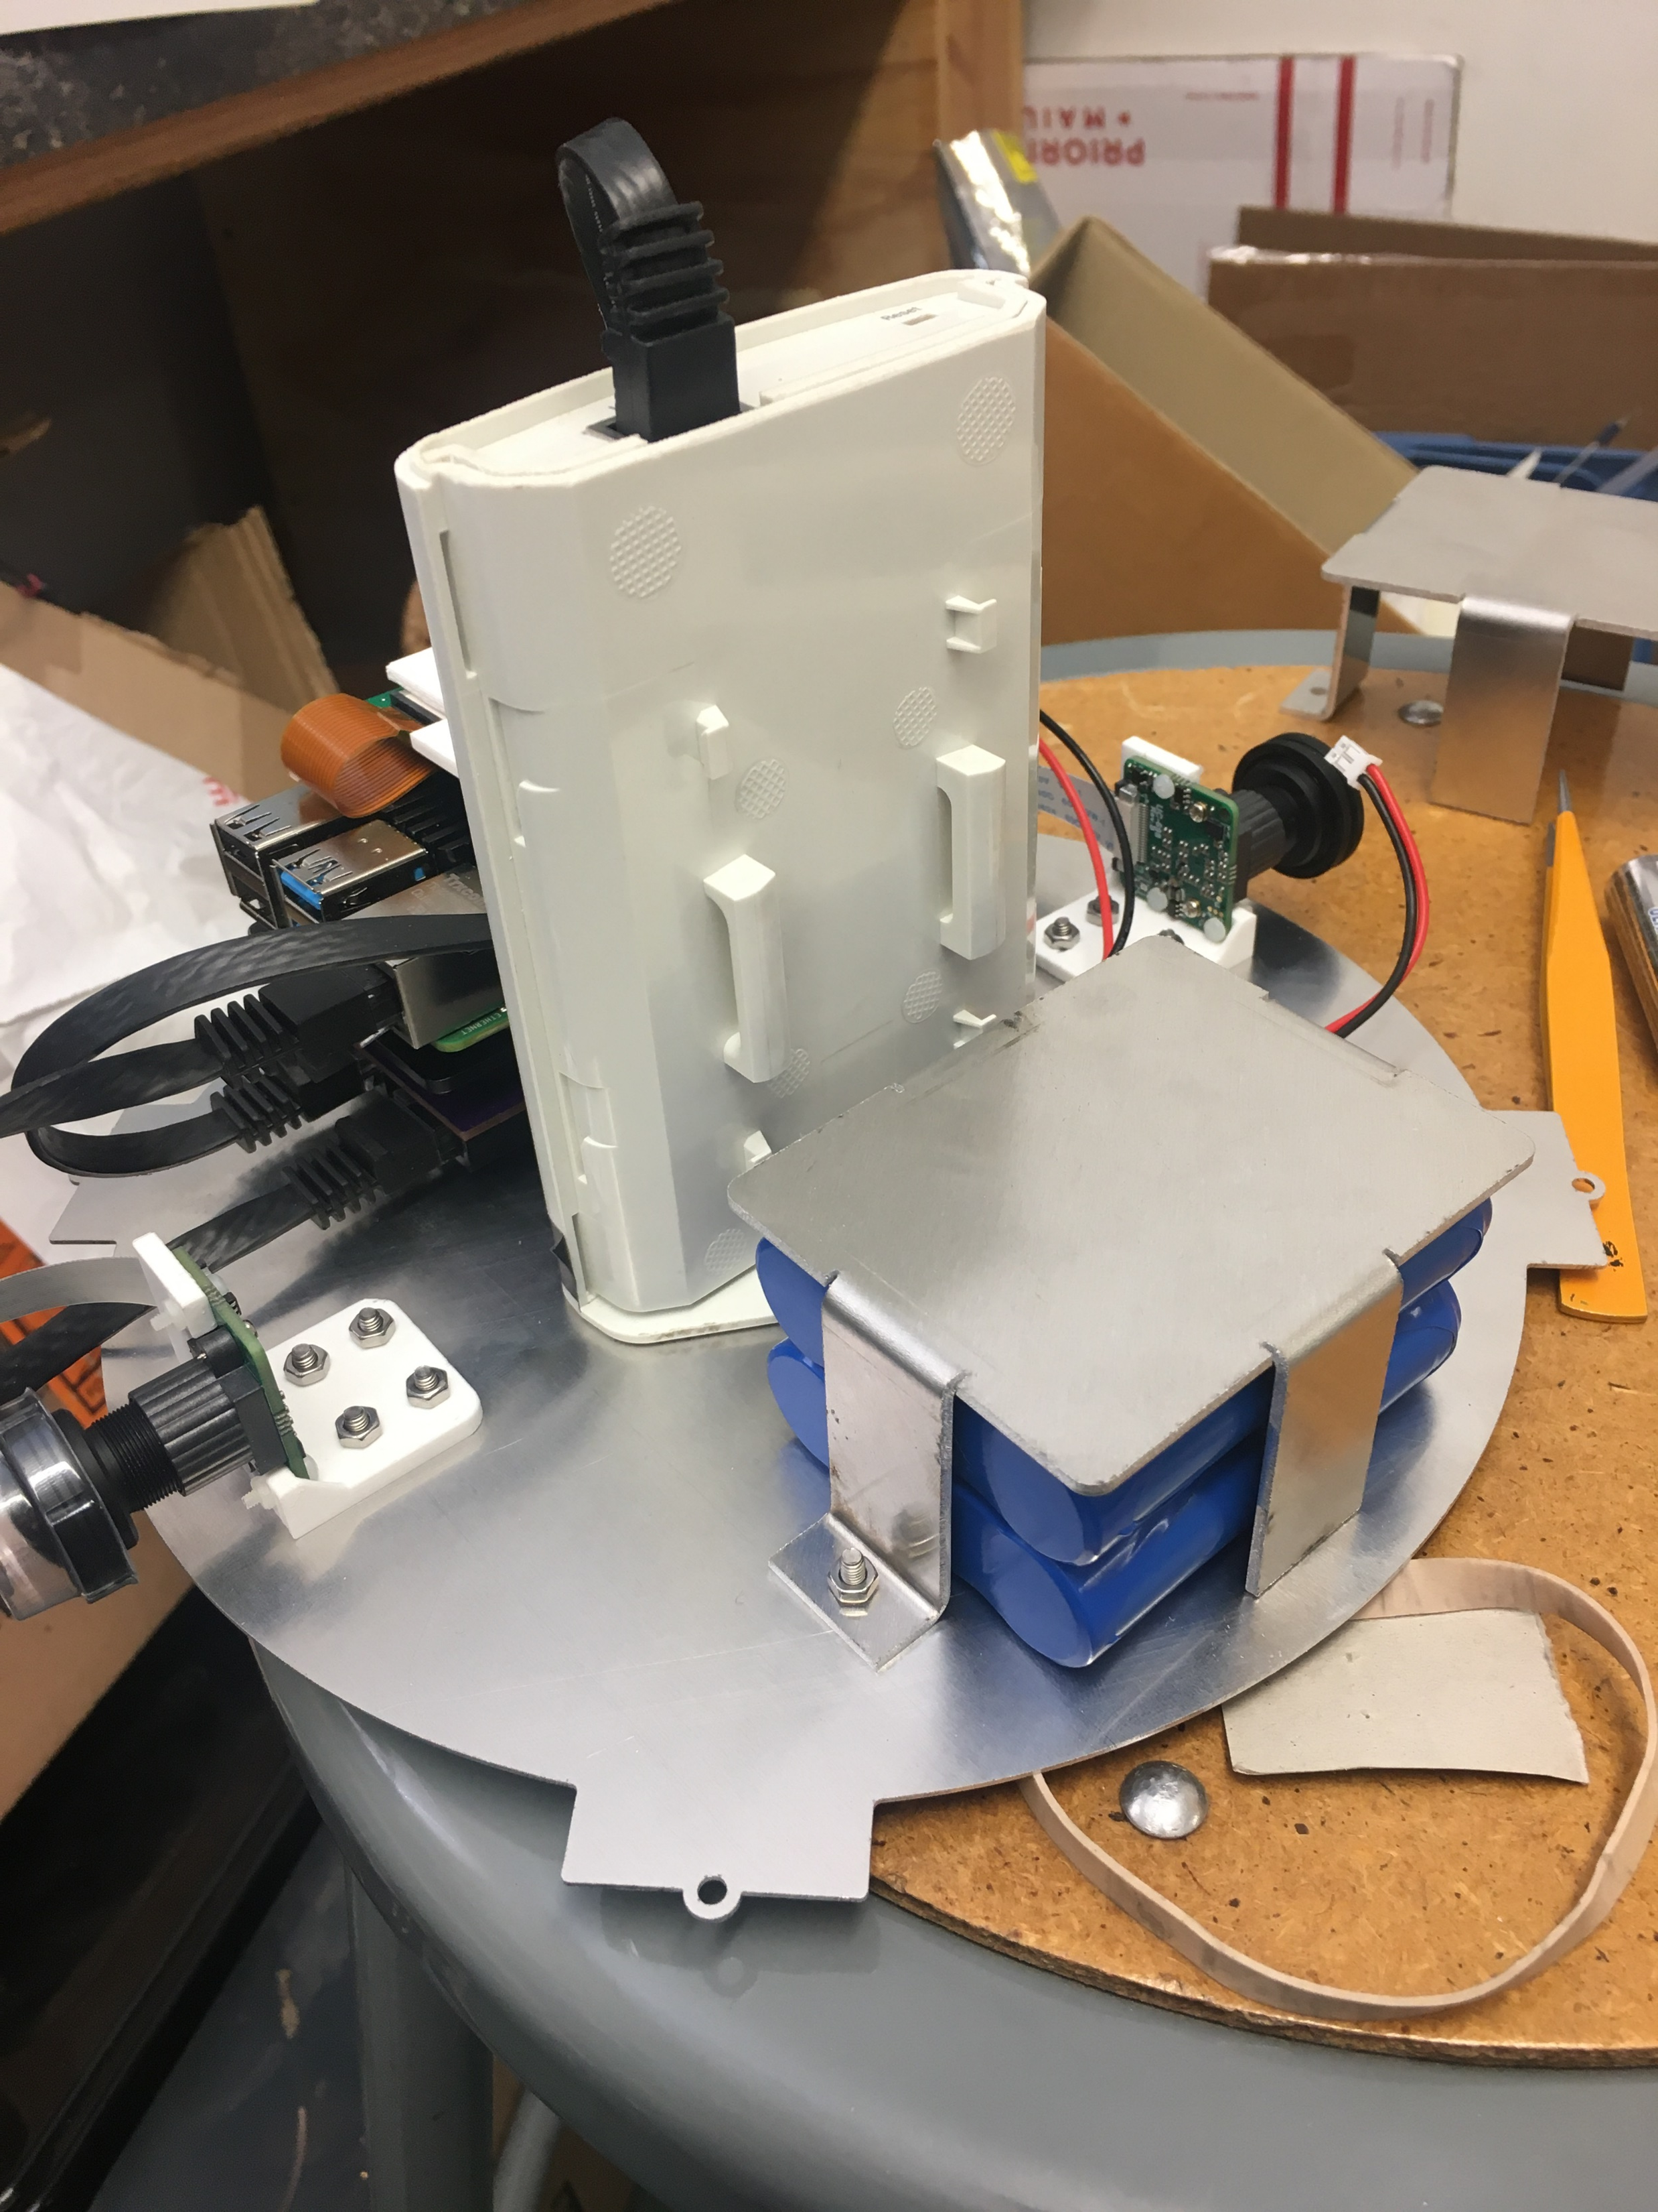
Video Streaming
Credit: Montana State University

Slide 18
Team Structure

Slide 19
Arizona State University
ASU Student Organizations
University of Arizona
Embry-Riddle Aeronautical University
Phoenix College
Glendale Community College
Casa Grande Union High School

Slide 20
Current Progress

Slide 21
Expected completion of module learning:
    May 12, 2023
Develop:
    System requirements
    Risks and Failure Mode and Effects Analysis (FMEA)
    Verification and Validation Plan

Slide 22
What to expect next

Slide 23
Assemble and test system components
Practice stratospheric balloon flights
It is GO TIME!

Slide 24
Acknowledgements

Slide 25
Dr. Thomas Sharp | Dr. Jnaneshwar Das
Desiree Crawl | Deborah Blair

Slide 26

Dr. Thomas Sharp | Dr. Jnaneshwar Das
Desiree Crawl | Deborah Blair
Dr. Steve Kortenkamp

Slide 27
Dr. Thomas Sharp | Dr. Jnaneshwar Das
Desiree Crawl | Deborah Blair
Dr. Steve Kortenkamp | Michelle Coe

Slide 28

Dr. Thomas Sharp | Dr. Jnaneshwar Das
Desiree Crawl | Deborah Blair
Dr. Steve Kortenkamp | Michelle Coe
Dr. Yabin Liao

Slide 29
Dr. Thomas Sharp | Dr. Jnaneshwar Das
Desiree Crawl | Deborah Blair
Dr. Steve Kortenkamp | Michelle Coe
Dr. Yabin Liao | Dr. Anne Boettcher

Slide 30

Dr. Thomas Sharp | Dr. Jnaneshwar Das
Desiree Crawl | Deborah Blair
Dr. Steve Kortenkamp | Michelle Coe
Dr. Yabin Liao | Dr. Anne Boettcher
Dr. Eddie Ong

Slide 31

Dr. Thomas Sharp | Dr. Jnaneshwar Das
Desiree Crawl | Deborah Blair
Dr. Steve Kortenkamp | Michelle Coe
Dr. Yabin Liao | Dr. Anne Boettcher
Dr. Eddie Ong | Dr. Tim Frank

Slide 32

Dr. Thomas Sharp | Dr. Jnaneshwar Das
Desiree Crawl | Deborah Blair
Dr. Steve Kortenkamp | Michelle Coe
Dr. Yabin Liao | Dr. Anne Boettcher
Dr. Eddie Ong | Dr. Tim Frank
John Morris

Slide 33

Dr. Thomas Sharp | Dr. Jnaneshwar Das
Desiree Crawl | Deborah Blair
Dr. Steve Kortenkamp | Michelle Coe
Dr. Yabin Liao | Dr. Anne Boettcher
Dr. Eddie Ong | Dr. Tim Frank
John Morris | Arizona Near Space Research

Slide 34
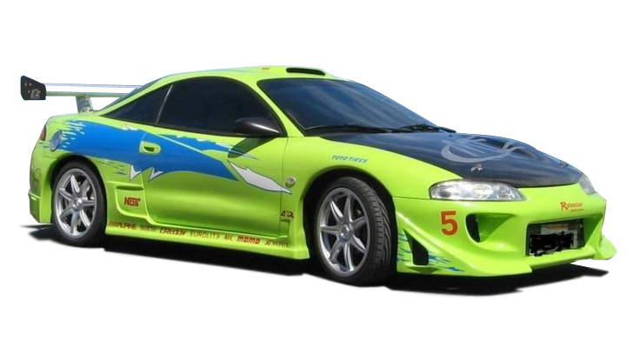

Slide 35

More Information
https://eclipse.montana.edu/

